Slide 1
Project Title: IMOR GASLIFT OPTIMISATION PROJECT
Charter Template
Business Case/objectives:
Need to identify short/medium/long term Gas lift Optimisation opportunities thereby increasing production and driving down unit OPEX in Imo river PU.
To fully automate the gas lift System in Imo river by so doing benefit quickly and optimally from gaslift .
Need for increase in wrench time of field operations personnel through synergy and elimination of overlaps in Make-it-Work (MiW) workstream.
Need for synergy and common ‘bottom-line’ business delivery.
Need to remain competitive and CSD positive.
Potential Benefits & Measurement:
Acceleration plan for closing the gap between IPSC and actual production of ca. 3000 bopd
Production Optimisation of all gaslifted conduits.
Project Scope/Actions :
Hold Gas Lift health check workshop to understand current realities and have a base case for improvement.
Repairs and calibration of hardware instrumentation including FCVs and field transmitters.
Ensure gas lift hardware is fully defined in SAP.
DCS-fieldware communication.
Develop a script for real time lift gas injection measurements during well tests.
Progress multirate tests to provide quality data to update Prosper models and optimal setpoint determination.
Carry out FG/BHP campaign of all gas lifted wells.
Carry out Gas lift valve change-outs (GLVCO).
Monitor well production performance from well tests ex- GLVCO.
Critical Success Factors:
Support from CWI, WRFM and AMIT teams
Adequate Budget
Availability of Asset personnel, WRFM & CWI to drive required changes (conflicting business priorities)
High-level Timeline:
L0-L1: Mar 2018
L2: April 2018
L3: May 2018
L4: July 2018
L5: October 2018
Initiative End
Project Sponsor: Ezugworie, Sam
Implementation Leads: Benjamin Obong & Gloria Erivona
Project Team: Benjamin Obong, Gloria Erivona, Attoni Success, Salisu Hassan, Richardson Oboro, Uche Nduka, Aribisala Ayodeji, Oginni Abiodun, Udo Uzochukwu, Enyi Ugwechi, Mamoke Akporuno, Offurum, Nmamkoche, Oruambo, Tamunomiete, Famofo-Idowu Olasunkami, Amos Martins, Conrad Ibekwe, Okpubuluku, Kevwe

Slide 2
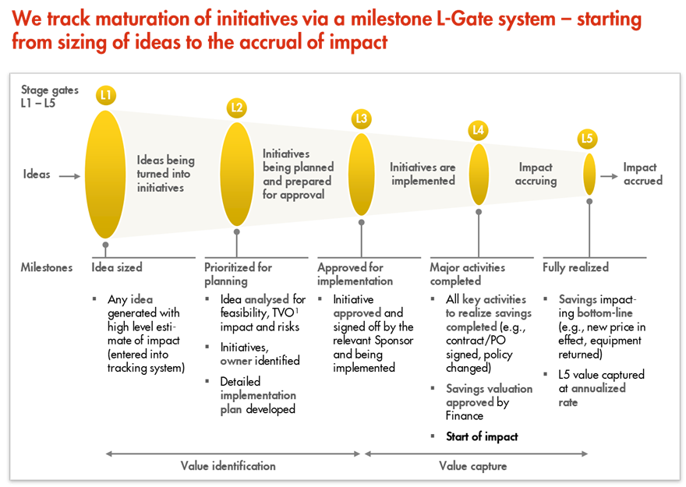
L1 – L5 Gates

Slide 3
Weekly Cadence Commitment Template Past 7 days
No. | Action | Action Party | Threat | Due Date | Status
10-4.1 | Carry out Gas Lift Health check workshop (Operations, WRFM, PTs, Process Engineering & Asset Engineering) | Ben/Gloria |  | xxxxxxxx
10-4.2 | Site visit by ROCI & Smart field Team | Amos/Kevwe |  | xxxxxxxx | New
10-4.3
10-4.4
10-4.5
10-4.6
10-4.7
10-4.8
10-4.9
10-4.10
10-4.11
10-4.12
10-4.13
10-4.14
10-4.15
10-4.16
Completed
Completed
New
On track
At risk
Delayed
Completed

Slide 4
Weekly Cadence Commitment Template Past 7 days
No. | Action | Action Party | Threat | Due Date | Status
10-4.1 |  |  |  |  | New
10-4.2 |  |  |  |  | New
10-4.3
10-4.4
10-4.5
10-4.6
10-4.7
10-4.8
10-4.9
10-4.10
10-4.11
10-4.12
10-4.13
10-4.14
10-4.15
10-4.16
New
On track
At risk
Delayed
Completed

